Slide 1
Grant Submissions in Neurobiology/ Otolaryngology
Amy Weinberg, MHP
Senior Administrative Director, Research Programs
Amy.Weinberg@childrens.harvard.edu
617.919.4023

Slide 2
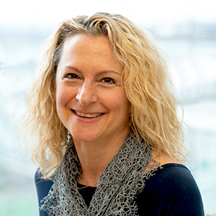
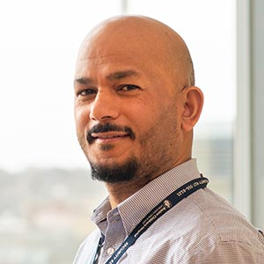
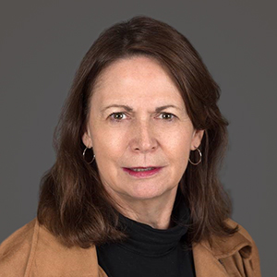
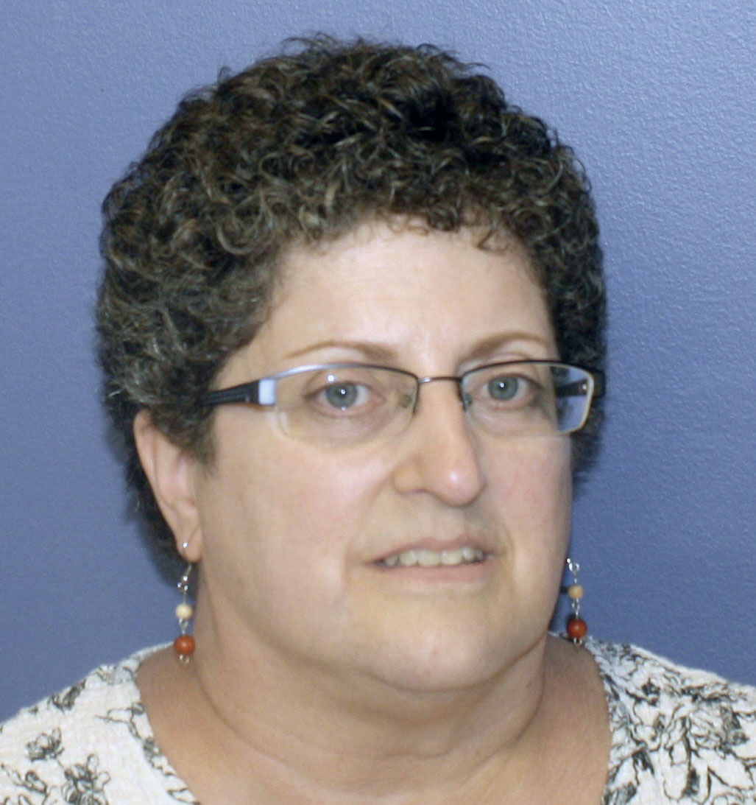
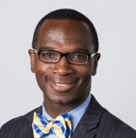
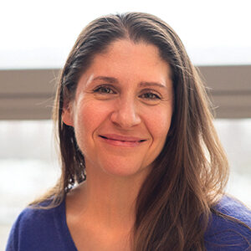
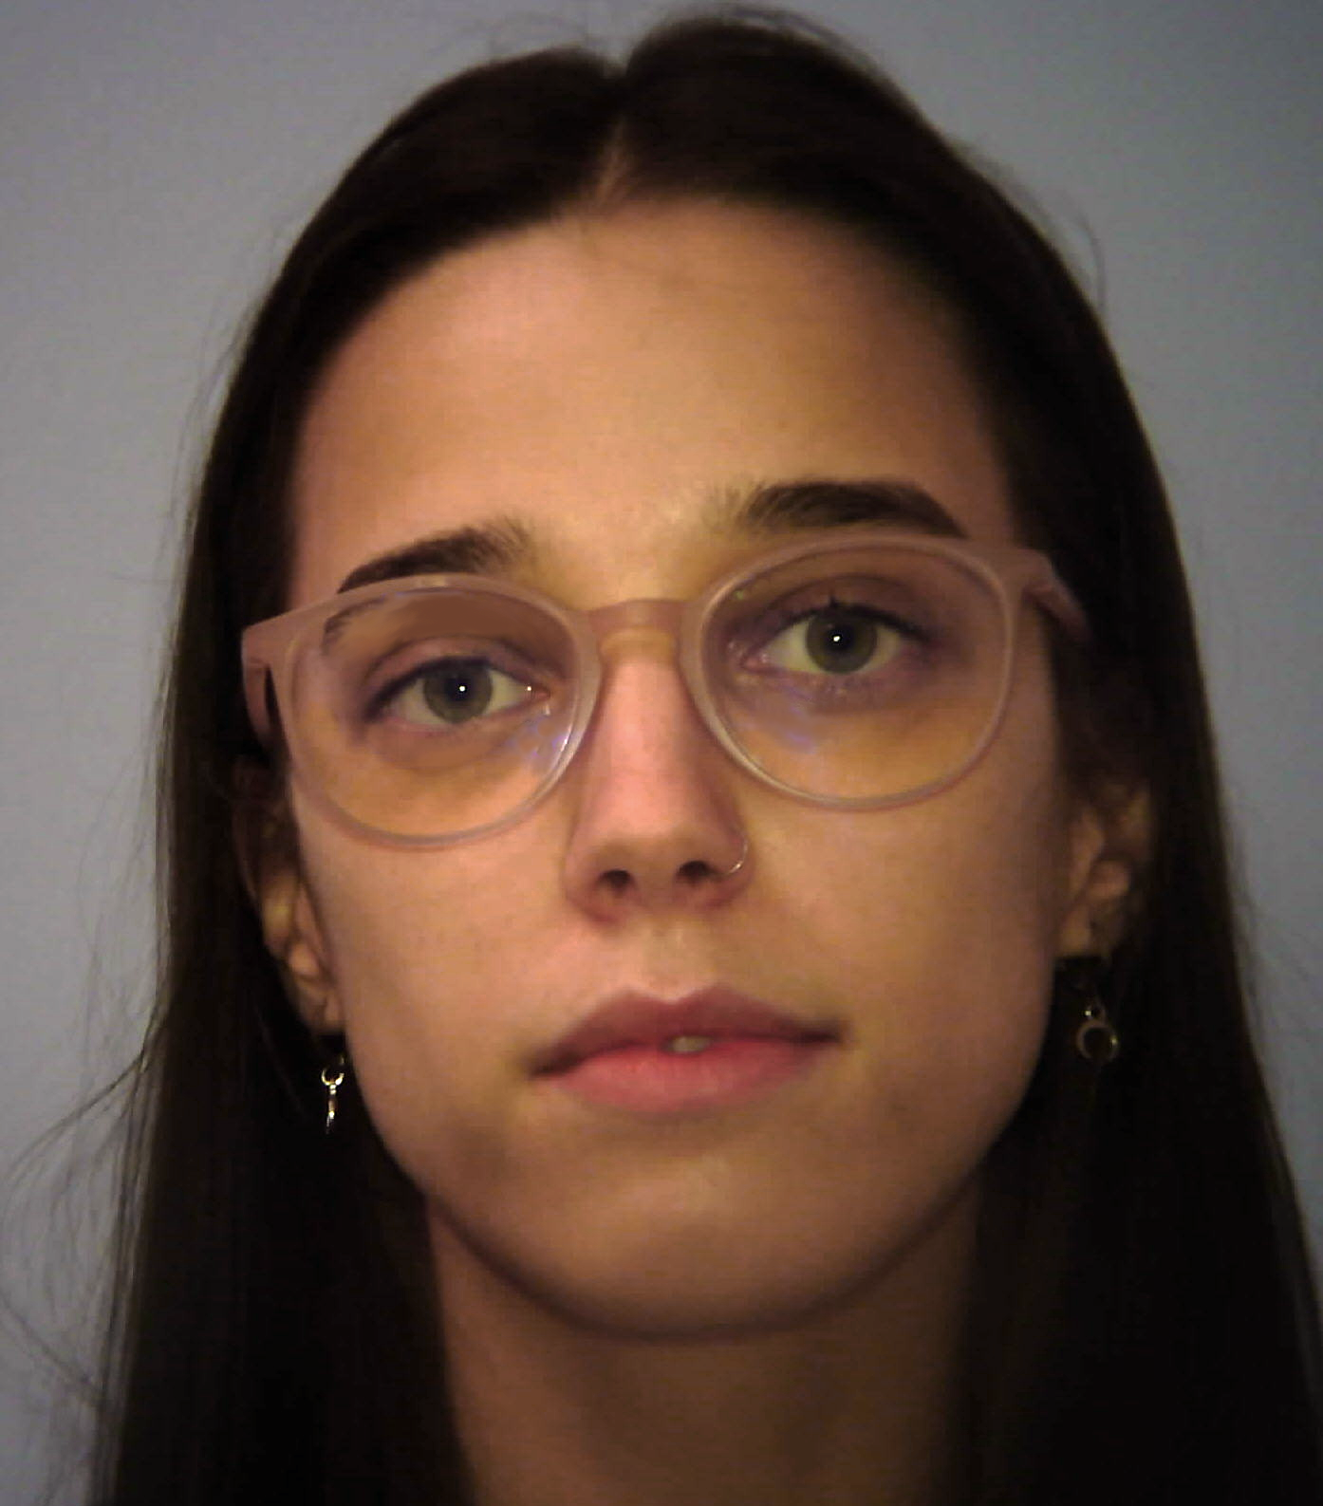
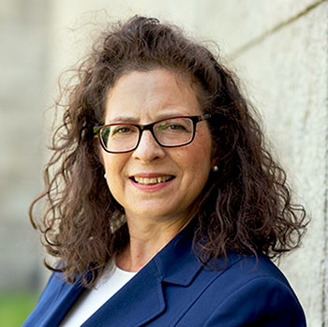
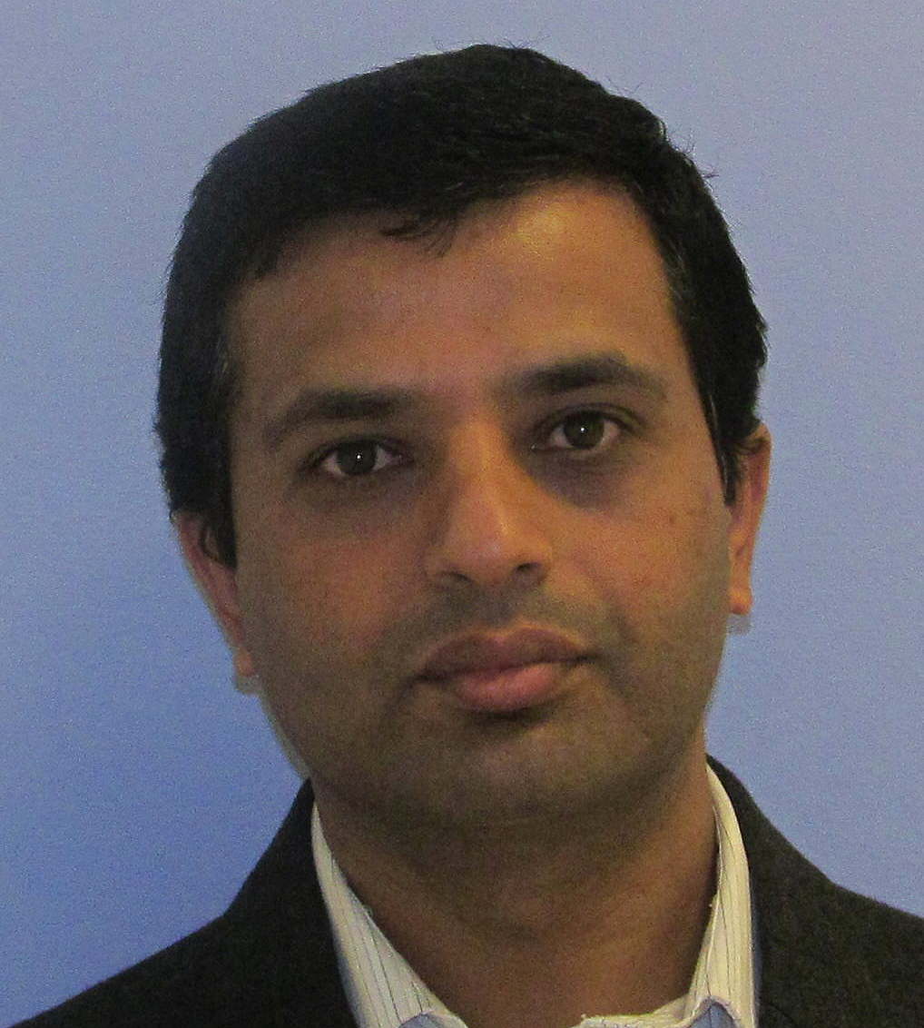
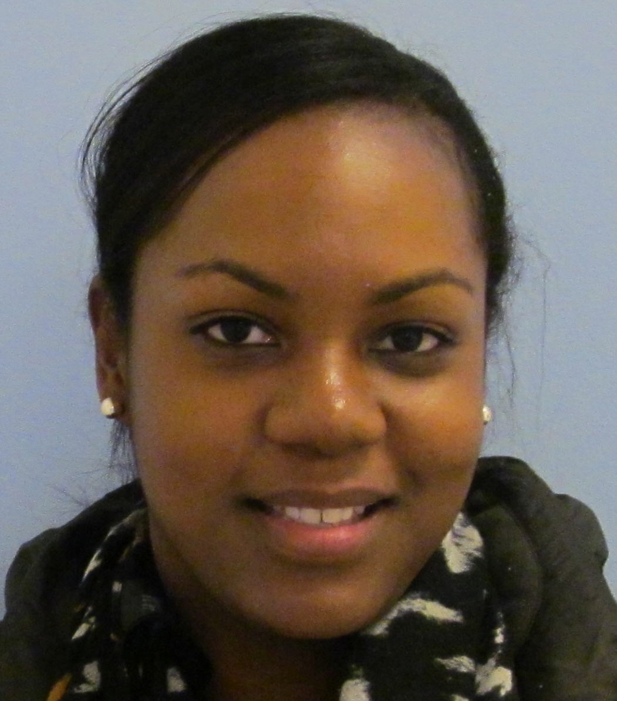
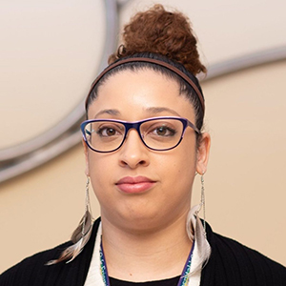
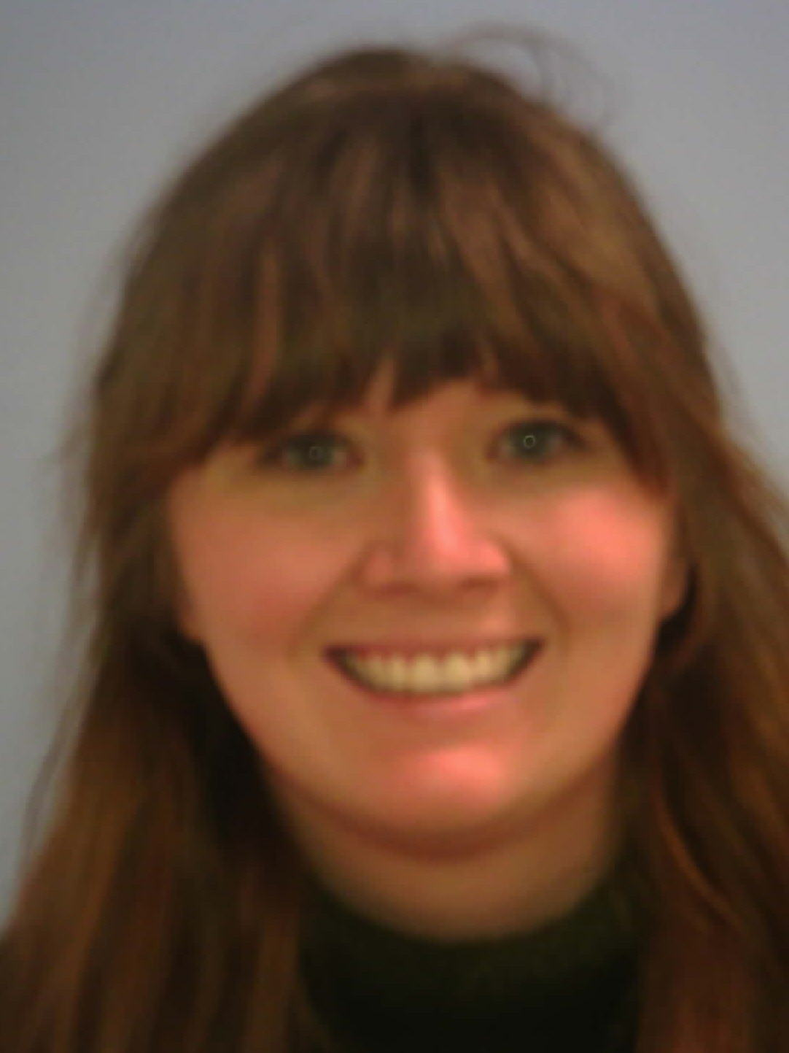
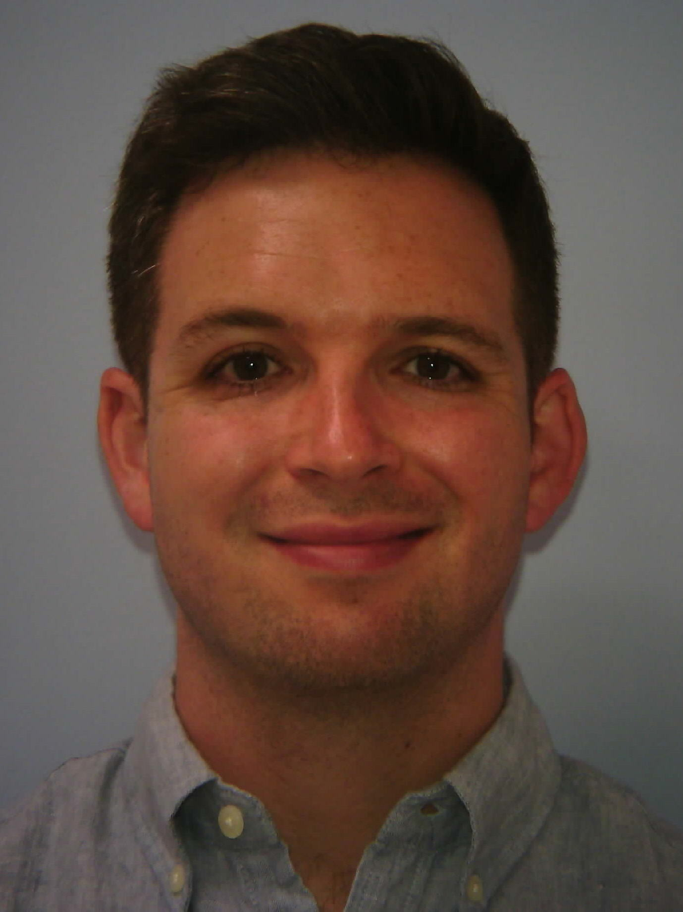
Research Administrative Support Structure
Amy Weinberg
Senior Administrative Director
Padam Gharti
Research Administrative Manager
Marie Boyle
Senior Research Administrator
Rett Studies/TNC
Robin Walker
Senior Research Admin. Pre-Award
Marlon Green
Clinical Research Manager 3
Karen Caballero/
Admin Manager 2
SJ Cunningham
EA/Pre-Award
Sylvia Lewinstein
Admin. Manager 2
IDDRC
Dipendra Subedi
Financial Asst/Billing Coord.
Kathy Rodrigues
Research Admin. 2
Robin Scott
Senior Research Admin.
Sable Smith Research Admin.
Katie Rogers
Program Coordinator 2
Jordan Bessette, Program Coordinator

Slide 3
Who is Eligible to Submit a Grant @ BCH
Applicant/Principal Investigator:
Is an employee at Boston Children’s Hospital or one of its affiliated Faculty Foundations
Received BCH Department, Division or Program Chair’s Approval
Has assigned research space at Boston Children’s Hospital
Will conduct more than 50% of the proposed work at Boston Children’s Hospital

Slide 4
BCH Grant Submission Policy
The complete and final proposal, as well as any attachments or approvals required by the sponsor, by must received at OSP at least five (5) full business days prior to the sponsor’s due date. The sponsor due date is defined as the date and time after which the sponsor will no longer accept proposals. In cases in which BCH is a subcontractor, the sponsor’s due date will be determined by the date due to the sponsoring institution.
OSP requires the following materials to perform its review:
Completed CHeRP online cover sheet (OLCS) with all approvals
COI declarations for all relevant employees
Final budget with justification
Final version of all administrative sections
Final science narrative, including aims, human subjects, and animal sections
If appropriate, letters of support and/or commitment
If appropriate, all subcontracts authorized documents
Any additional documents as may be required by the sponsor or prime institution

Slide 5
BCH Grant Submission Policy
If an occasional extension to the five-day rule is needed, the PI or research administrator should contact their assigned Grant Officer in the Office of Sponsored Programs with a reasonable alternative date when application materials will be submitted to OSP. The Grant Officer will consult with OSP leadership and, if needed, the Vice President for Research Administration, and will respond within 24 hours.
FY21
# of Submissions # subawards
#1: Neurobiology 94 64
#2: Neurology 69 46
#3: Otolaryngology 18 6
181 116
Total: 297; 6 administrators, approximately 50 agreements per person

Slide 6
NEW Neurobiology/ORL Submission Policy
Investigators in Neurobiology/ORL who need to submit outside of the 5-day review period must contact the following:
Neurobiology – Clifford.Woolf@childrens.Harvard.edu (Includes: Engle, Lipton, Poduri, Rosenberg, Rotenberg)
ORL – Michael.Cunningham@childrens.Harvard.edu
These leaders will need to provide approval before a research administrator can engage with late submissions.
We will no longer accommodate all late submissions, as we do not have staffing levels sufficient to engage in last minute proposals.
Other support takes a lot of time to generate and should not be requested at the last moment.

Slide 7
Common Pitfalls
Investigators rushing submissions to try to accommodate prime institutions when asked to be a subcontractor at the last minute
Agreeing to be a consultant instead of a Co-Investigator
Agreeing to a salary billing agreement instead of a subcontract
Committing more effort than required
Committing more effort than you have available
Committing effort without compensation (cost-sharing)
Not taking salary increases into account
Cutting budget to accommodate sponsor or prime, but with a larger scope of work than can be accomplished with requested resources.

Slide 10
Post Submission Procedures
Prepare and submit protocols
Put dates of grant review on your calendar; check status; provide JIT information as requested; submit any late materials
Work with post-award administrator on plan for labor and expense allocations over the first year of the project. Schedule calls for subs.
Receive award notice! Be sure to note all award terms, conditions, and reporting requirements
Contact dept. pre-award contact to initiate fund set up; complete paperwork as needed. Post jobs if needed. Notify subs
Begin work on your project. Request changes from sponsor as needed. Comply with all reporting requirements.
Think about your next project. Good to space out grant submissions and seek funding from various sponsor types.

Slide 11
OSP: Issues/Sticking Points
Late and/or Incomplete Application Submissions
Late and/or Overdue Reports to Sponsors
Enforcing Federal Government Policies and Regulations
PHS Conflict of Interest Disclosure and Training
NIH Foreign Influence and Foreign Component

Slide 12
OSP: On the Intranet

Slide 13
OSP: On the Intranet

Slide 14
OSP: On the Intranet

Slide 15
Some of Our Partners
Office of Sponsored Programs
Clinical Trials Business Office: Guidance on federal or nonprofit-sponsored clinical trial agreements and or agreements with clinical research terms IACUC: Verify protocol approval for projects involving vertebrate animals
IRB: Verify protocol approval for projects involving human subjects/materials
Office of General Counsel: Guidance on Agreements with troublesome terms and conditions
Conflict of Interest: PHS disclosures and FCOI reporting
Research Compliance: Grant information related to compliance issues
Research Administration: Infrastructure support
Research Finance: Our post-award counterpart
Technology and Innovations Development Office: Guidance on Agreements with troublesome Intellectual Property terms and conditions
The BCH Trust: Source of Foundation Funding Opportunities

Slide 16
What is a Sponsored Project?
Sponsored projects include research, instruction and training, public service, fellowships and other scholarly and creative activities conducted under the direction of the Institution’s faculty and staff and funded by an outside source in accordance with award instruments containing one or more of the following provisions:
The proposed work binds Institution to a specific line of scientific inquiry, which usually requires a statement of work, grant application or proposal.
The submission (and approval) of a budget is required.
The funds are given to accomplish specific research objectives (as opposed to providing support for a general area of research) within a specific time frame.
Funds are to be used only for activities approved in advance by the sponsor.
There is a requirement for technical or detailed financial reports (e.g., by cost category) or for some other outcome or product of the activity, to be delivered to the sponsor during or at the completion of the activity.
A time period is specified during which activities are to be conducted and completed.
There are requirements for audits by or on behalf of the funding source.
Terms for the disposition of rights in tangible or intangible property (data rights, copyrights and inventions) developed or obtained during the activity are included.
The requirement for unexpended funds to be returned to the sponsor at the completion of the activity is specified.
Office of Sponsored Programs

Slide 17
Gifts vs. Grants
Factor | Gifts | Grants
Source | Individuals, Non Profit Organizations, Corporations, Corporate Foundations, Family or Individual foundations. | Government Agencies, Nonprofit Organizations, Corporations, Corporate Foundations.
Purpose | Donor may specify an area of interest or a goal to be funded. | Sponsor specifies how the funds should be used, as outlined in the budget, scope of work, award letter, or grant agreement.
Value Exchange | Recognition. | Recognition and/or Reporting.
Reporting | Little or no obligation to report to Donor on how the gift is used or invested. Reporting is used as an opportunity for Donor stewardship. Limited to how, when, and to whom funds were disbursed; statement of earnings as applicable. | Sponsor requires performance of specific duties such as research, financial/budget reports, and progress reports.
Document | Letter of Donation/ Gift Agreement. | Award Letter/Agreement, Grant Agreement.
Deadline/Terms | Typically no time period is associated with the use of funds. | Typically requires a specific time period for conducting projects.
Excess/Unused Funds | Not Applicable | Typically returned to sponsor.
Penalty for Nonperformance | No penalties for not using funds. | Penalties may exist for failing to use the funds or to deliver the items on a timely basis.
Sponsor Rights to Licensing and/or Intellectual Property | Not Applicable | Typically include terms and conditions about rights to Intellectual Property, including data, copyrights, or inventions.
Basic Research Tax Credit | Not Applicable | May require that research be performed by a qualified organization or certain tax-exempt organizations. Qualified = educational or tax-exempt organizations as defined in the Internal Revenue Code.
Legal Accountability | Not Applicable | Typically include indemnification or other legal accountability terms.

Slide 18
OSP’s Responsibilities:
Identifying funding sources and opportunities
Reviewing applications for submission to Sponsors
Collecting, reviewing, and submission of Just-In-Time Information (JIT) to NIH and other Sponsors
Accepting awards on behalf of BCH
Issuing, receiving, and negotiating subawards to and from BCH and collaborating institutions
Serving as the primary interface with federal and nonprofit Sponsors and with peer institutions collaborating with BCH investigators
Ensuring compliance with all applicable Sponsor, government, and BCH compliance regulations, requirements, and policies

Slide 19
OSP: Our Contacts
Theresa Applegate, Director, Joined OSP in 2007
Paul Santos, Manager, Joined OSP in 2010
Kamei Miller, Senior Grant Officer, Joined OSP in 2015

Slide 20
IRB
If you need IRB approval for your project, please contact your research administrator to learn about next steps.

Slide 21
Any Questions?

